Slide 1




KIT’s College Of Engineering, Kolhapur
EVENT MANAGEMENT FOR COLLEGE CLUB
BY-
Karishma Mujavar C-26
Samrudhi Bongale C-05

Slide 2

Obejective
1. Improve Inter-Club Coordination – To facilitate seamless communication and collaboration among different college clubs.
2. Avoid Event Clashes – To prevent scheduling conflicts by maintaining a centralized event calendar.
3. Optimize Resource Sharing – To efficiently allocate venues, equipment, and budgets across multiple clubs.
4. Standardize Event Planning – To implement a structured system for event approvals, planning, and execution across clubs.
5. Improve Documentation & Feedback – To maintain records of events, feedback, and best practices for continuous improvement.

Slide 3
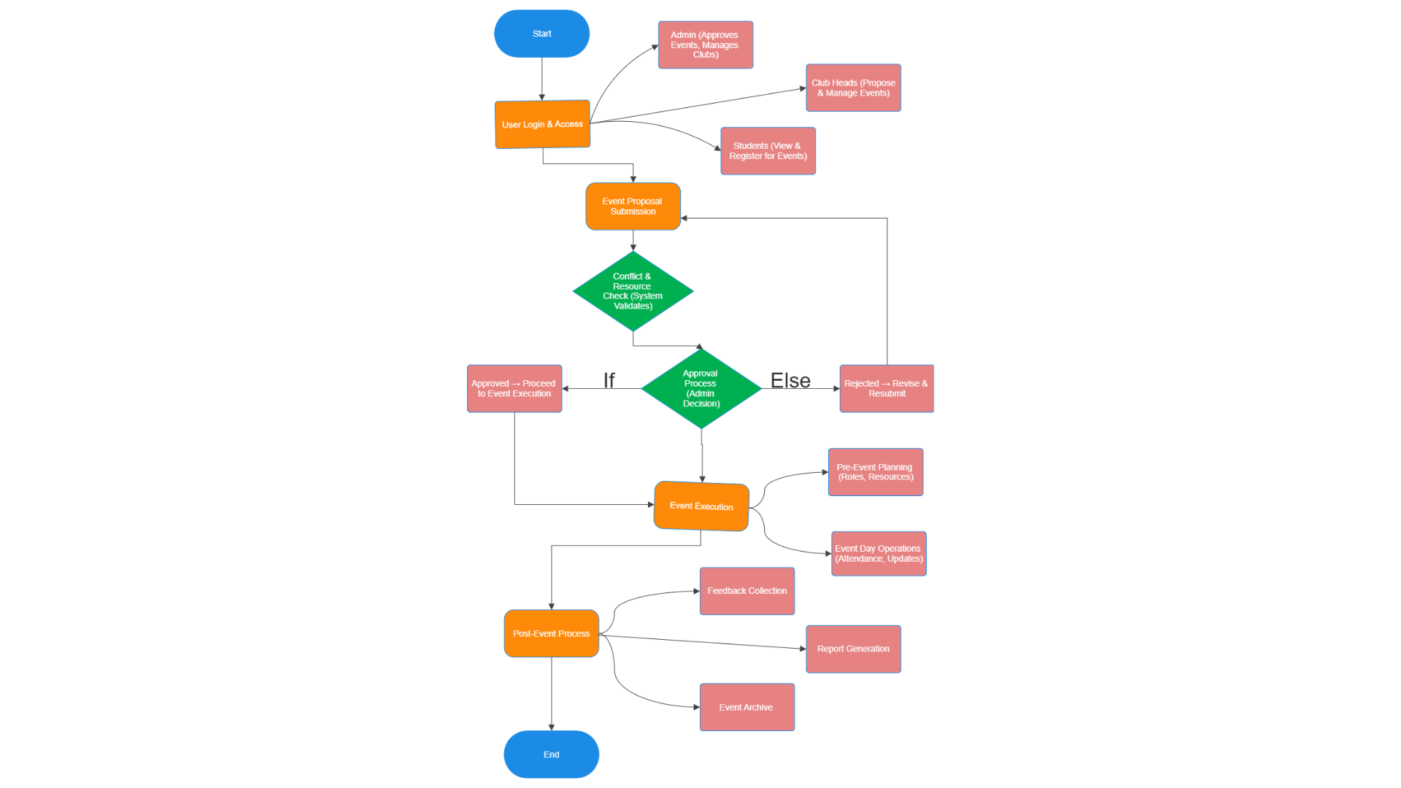
Methodology

Slide 4

Techniques
Frontend:
HTML,
CSS,
JavaScript,
React.js
or
Angular.js for UI.
Backend:
Node.js,
Django,
or
Flask for event data handling.
Database:
MySQL,
PostgreSQL,
or
Firebase for storing event records.

Slide 5
Technologies
Obejective
Technology | Purpose
HTML, CSS, JavaScript | Designing the user interface
React.js / Vue.js | Creating a dynamic frontend
Node.js + Express.js | Handling backend operations
MySQL / MongoDB | Storing event & user data
Firebase / WebSockets | Real-time notifications & updates
Google Calendar API | Event scheduling integration
Firebase Cloud Messaging | Sending event alerts
AWS / Heroku / Vercel | Hosting & deployment
1. Improve Inter-Club Coordination – To facilitate seamless communication and collaboration among different college clubs.
2. Avoid Event Clashes – To prevent scheduling conflicts by maintaining a centralized event calendar.
3. Optimize Resource Sharing – To efficiently allocate venues, equipment, and budgets across multiple clubs.
4. Standardize Event Planning – To implement a structured system for event approvals, planning, and execution across clubs.
5. Improve Documentation & Feedback – To maintain records of events, feedback, and best practices for continuous improvement.

Slide 6
Conclusion
Obejective
The Event Management System ensures seamless coordination between various college clubs.
It provides real-time synchronization to avoid scheduling conflicts and improve event visibility.
The system automates notifications and reminders, enhancing student engagement.
A role-based access system ensures secure and organized management of club events.
The platform reduces manual work, making event planning more efficient and error-free.
Integration with Google Calendar and real-time updates enhances user convenience.
Future enhancements may include mobile app support and AI-based event recommendations.
This project serves as a scalable solution that can be expanded to multiple institutions.
1. Improve Inter-Club Coordination – To facilitate seamless communication and collaboration among different college clubs.
2. Avoid Event Clashes – To prevent scheduling conflicts by maintaining a centralized event calendar.
3. Optimize Resource Sharing – To efficiently allocate venues, equipment, and budgets across multiple clubs.
4. Standardize Event Planning – To implement a structured system for event approvals, planning, and execution across clubs.
5. Improve Documentation & Feedback – To maintain records of events, feedback, and best practices for continuous improvement.

Slide 7
Obejective
References
Reference Websites:-
https://www.poddarbschool.com/club-event-calendar#Spandan%20club
Research Paper
Life skills through Event Management in Undergraduate Education:-
https://www.researchgate.net/publication/357699684_Life_skills_through_Event_Management_in_Undergraduate_Education
2.The Influences of Student Club Events on Students Studying in Linnala Campus:-
https://www.researchgate.net/publication/336532594_The_Influences_of_Student_Club_Events_on_Students_Studying_in_Linnala_Campus
1. Improve Inter-Club Coordination – To facilitate seamless communication and collaboration among different college clubs.
2. Avoid Event Clashes – To prevent scheduling conflicts by maintaining a centralized event calendar.
3. Optimize Resource Sharing – To efficiently allocate venues, equipment, and budgets across multiple clubs.
4. Standardize Event Planning – To implement a structured system for event approvals, planning, and execution across clubs.
5. Improve Documentation & Feedback – To maintain records of events, feedback, and best practices for continuous improvement.

Slide 8
Thank You

